Slide 1
Tog Coders Night 1#
Tools for programming in C Language
By Paul McQuade <paulmcquad@gmail.com>
Twitter: @paulmcquad
https://github.com/paulmcquad/Tog-Coders-Night

Slide 2
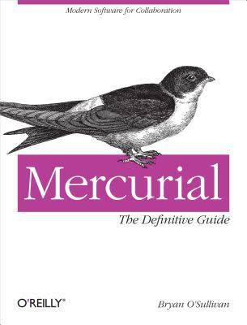
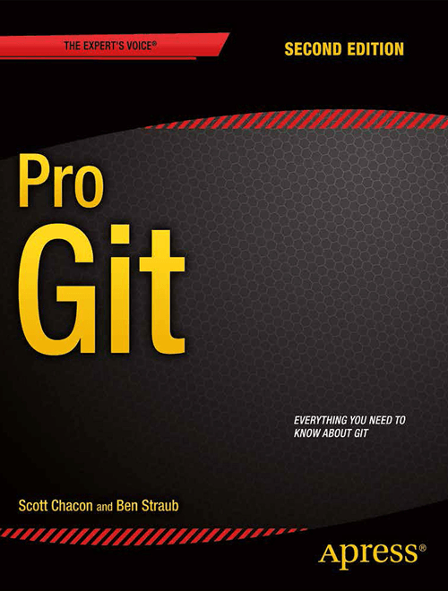
Distributed Revision Control System
Git
Mercurial
GNU Bazaar

Slide 3
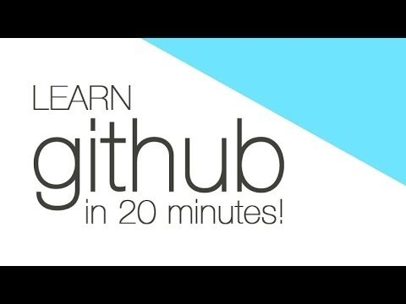
Source Hosting Sites
Github
Bitbucket
Sourceforge
Codeplex

Slide 4
Editors & IDE’s
Vi/Vim
Emacs
Nano
Gedit
Notepad++
Codeblocks
Eclipse
Netbeans
Visual Studio
Xcode

Slide 5
Complier & Debugger
GNU GCC
Clang
GNU GDB
X64dbg
Valgrind

Slide 6
What next?
Check out some of my C programs: Tog-Coders-Night\C\code
Compile the code:
Create an account on Github/ Bitbucket/ Sourceforge etc.
Write some basic programs:

